Slide 1
Introduction to SOLID principles.
SOLID principles are 5 simple rules that help developers write clean, and flexible code that doesn’t break easily when we make changes.
SOLID principles were designed to make the job of developers easier. As it helps reduce tight coupling, increase code reusability, and make systems scalable and maintainable.
Lets Understand it better.
Before , developers used to write huge code which included huge classes, tight coupling , complex if-else conditions and small change could crash entire program.
So, as the requirement increased over the time, new features get added consistantly, the headcount of developers working on technology increased over the time.
This created the problems like hard to read and understand code. Difficult to scale, test and maintain the code.
Purpose of SOLID Principles.
1. Reduce Tight Coupling Classes should not depend heavily on each other
2. Increase Maintainability Easy to modify without breaking existing code
3. Improve Scalability Easy to add new features
4. Improve Testability Easier to write unit tests
5. Make Code Understandable Any developer can read & extend it

Slide 2
Types of Solid Principles
The SOLID principles are a set of five design rules.
S - Single Responsibility Principle (SRP) A class should have only one job or reason to change.
O - Open-Closed Principle (OCP) Code should be open for extension but closed for modification.
L - Liskov Substitution Principle (LSP) Subclasses should be able to replace their parent classes without breaking the app.
I - Interface Segregation Principle (ISP) Don't force a class to implement methods it doesn't need; use multiple small interfaces.
D - Dependency Inversion Principle (DIP) Depend on abstractions (interfaces) rather than concrete tools or low-level classes.

Slide 3
Liskov Substitution Principle (LSP).
It was named after Barbara Liskov, a pioneering American computer scientist.
Liskov Substitution Principle (LSP) means that a child class must be able to replace its parent class without breaking the program or causing unexpected behavior. In simple words A "child" must be able to do everything the "parent" promised.
How is it useful?
It prevents "unexpected behavior" where a subclass changes how a system works in ways the developer didn't anticipate.
Without LSP, you end up writing complex code logic using multiple if () {} else { } statements. This makes code hard to read and maintain.
It stops developers from forcing inheritance just because two things are "kind of" related.

Slide 4
Liskov Substitution Principle (LSP).
Let’s Understand it with example.
In the Bird category all the bird species are included. They have some different qualities than each other sometimes.
Lets make two classes 1. Class Bird and 2.Class Ostrich. Now here the bird class says that birds can fly. If we use inheritance such that Class Ostrich inherits from Class Bird.
Ostrich belongs to the bird category but it cannot fly. This violets the LSP principle.
This is solved by using interface. Now adding fly in the Bird class will be wrong. So we make interface and add a quality Fly for the birds who fly.
Now Only birds that can fly will use Fly feature from Interface.
Conclusion: The birds which cannot fly but still belong to the bird category will not be forced to have a quality of flying.

Slide 5
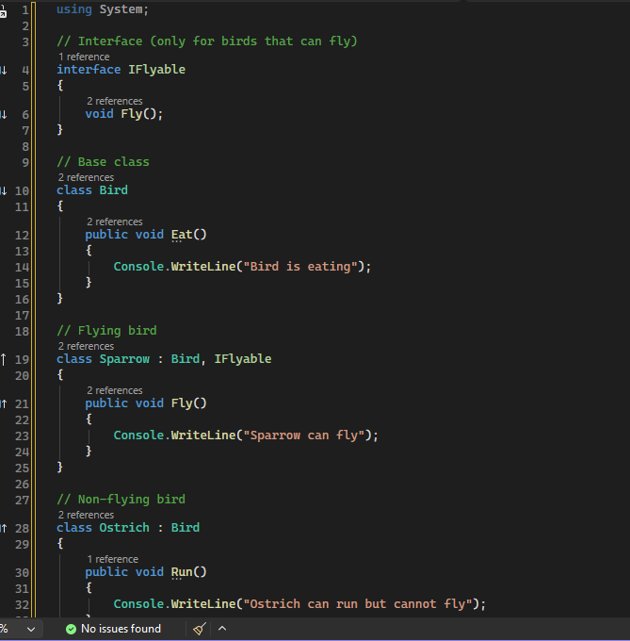
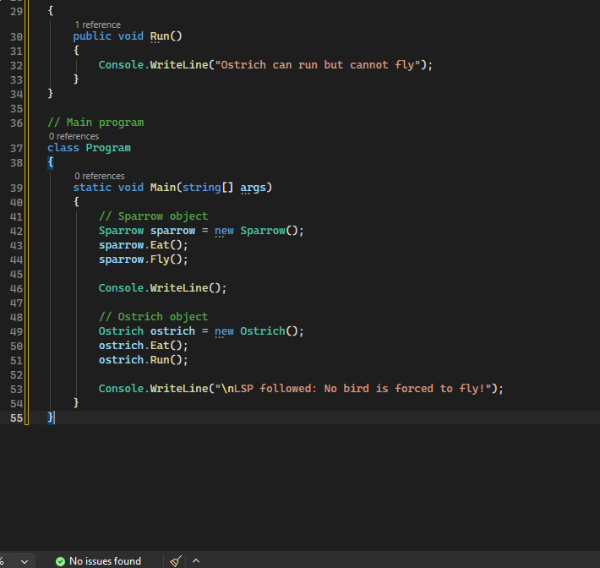
Simple Demonstration.

Slide 6
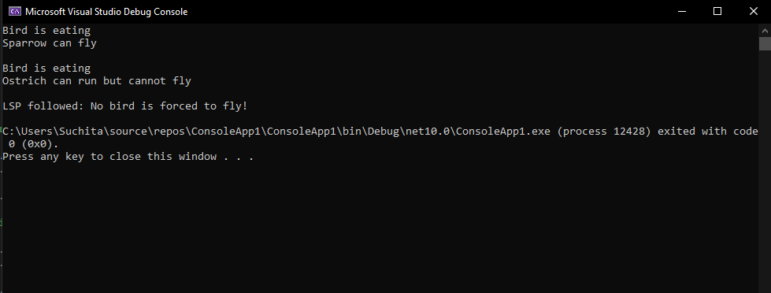
Output.

